Slide 1

Review Materi
Artificial
Intelligence

Slide 2
artificial intelligence
“the designing and building of intelligent agents that receive percepts from the environment and take actions that affect that environment”
Russel & Norvig, 2016 “Artificial Intelligence: A Modern Approach”

Slide 3
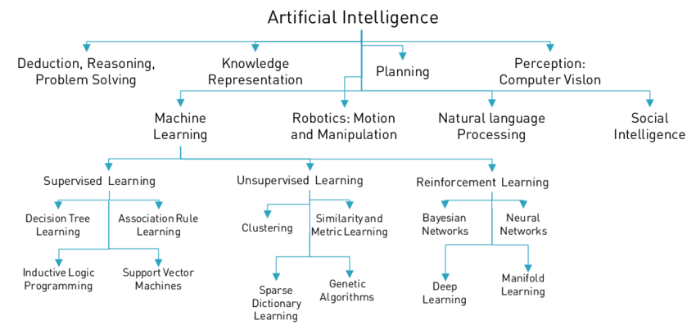
Artificial Intelligence Overview
Notes:
Sumber: https://www.researchgate.net/figure/AN-OVerVieW-OF-NOTABLe-APPrOACHeS-AND-DiSCiPLiNeS-iN-Ai-AND-MACHiNe-LeArNiNg-101_fig5_316983844

Slide 4
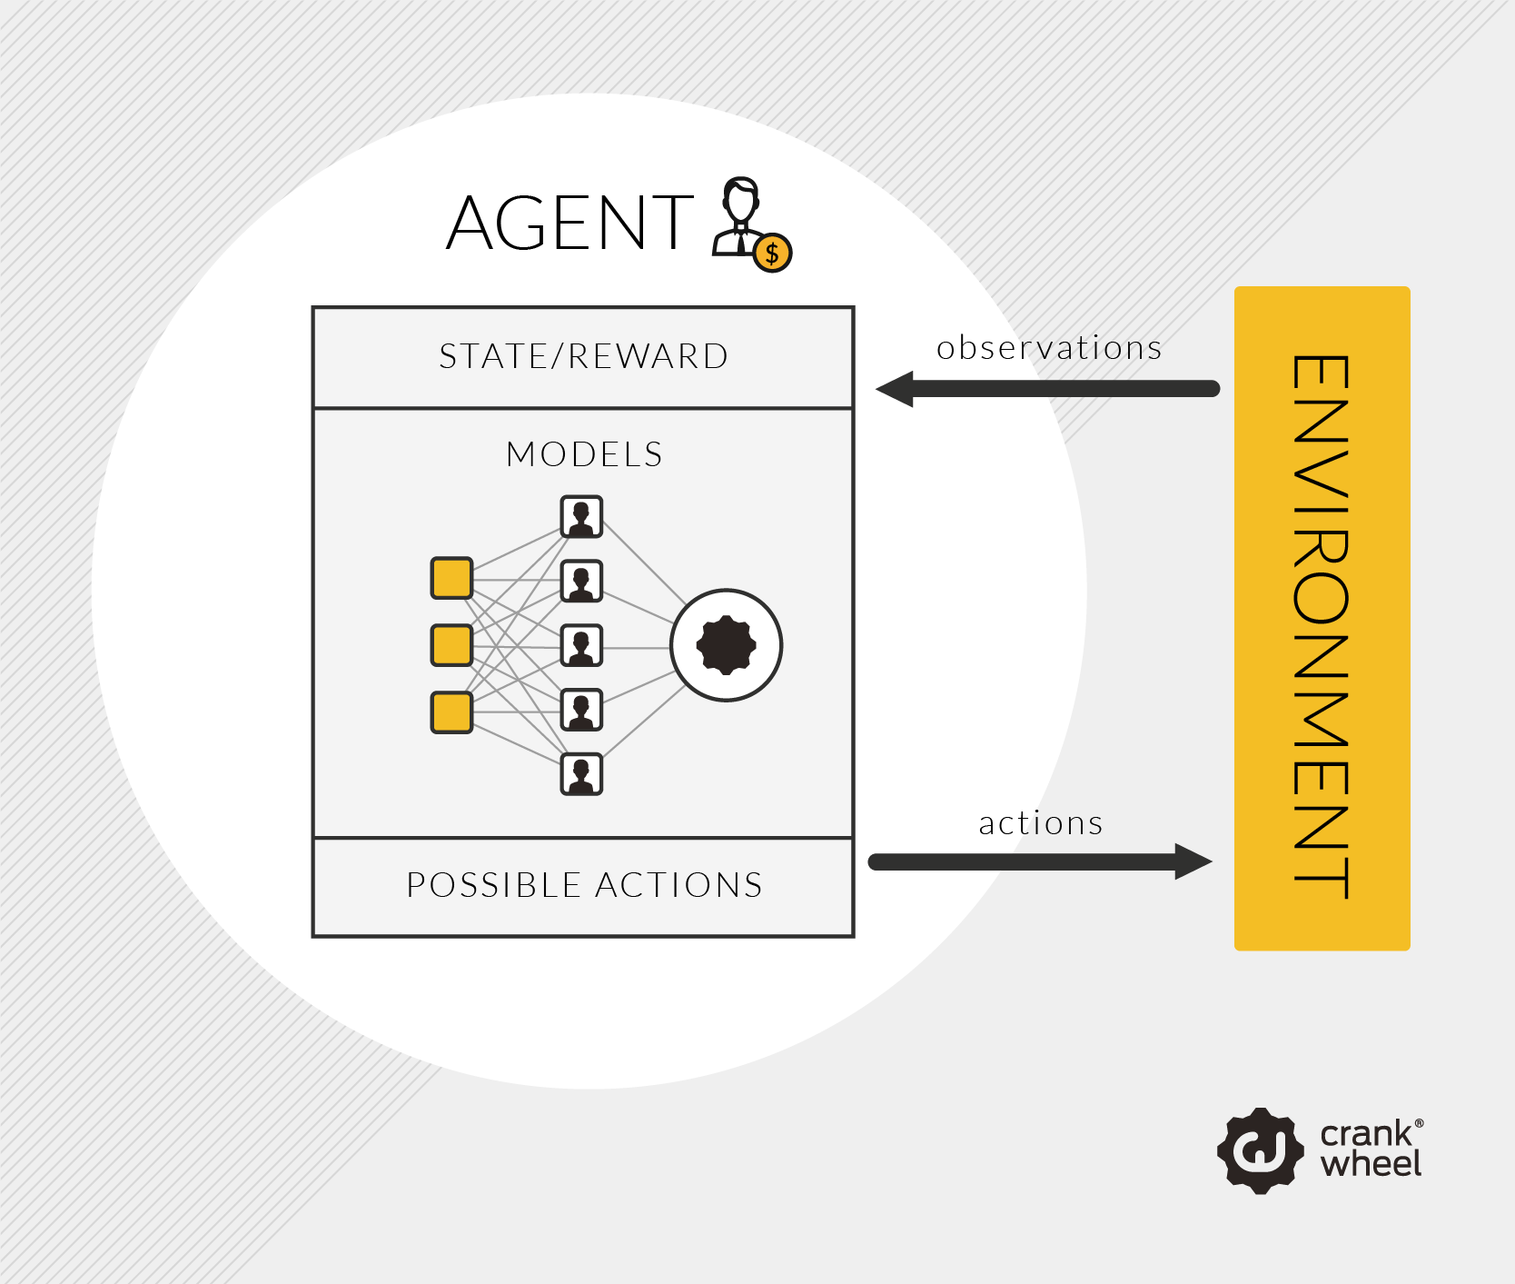
Cara Kerja AI

Slide 5
Pencarian
Blind search
Breadth First Search (BFS)
Depth First Search (DFS)
Heuristic search
Best First Search (BFS)
A*
Hill Climbing Search
Searching

Slide 6
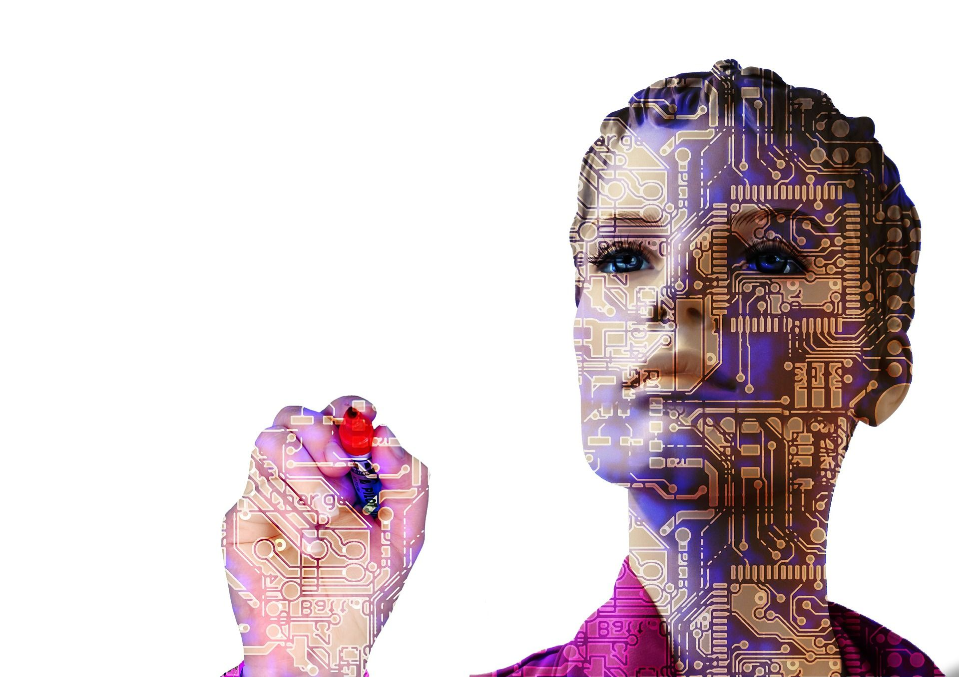
Machine Learning
Supervised Learning
Decision Tree
Naïve Bayes
K-NN
Unsupervised Learning
Clustering: K-Means, K-Medoids, dll
Reinforcement Learning
Neural Network
Deep Learning

Slide 7
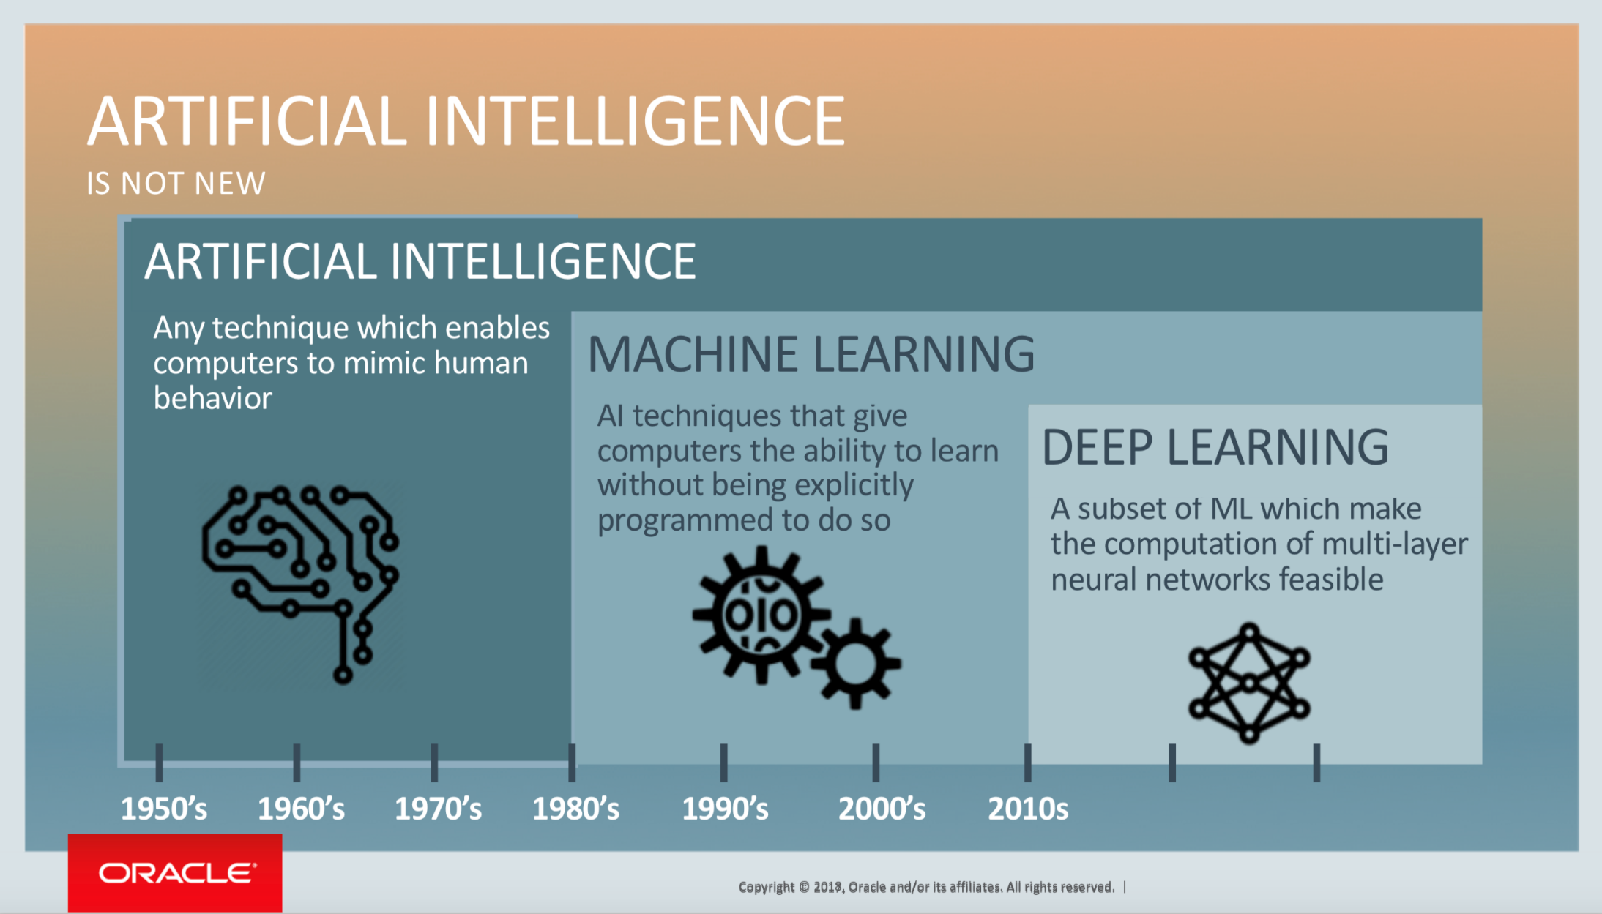
Deep Learning

Slide 8
computer vision ?
Computer vision is an interdisciplinary field that deals with how computers can be made to gain high-level understanding from digital images or videos. From the perspective of engineering, it seeks to automate tasks that the human visual system can do.
Notes:
Sumber: https://en.wikipedia.org/wiki/Computer_vision

Slide 9

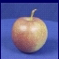
Pattern Recognition
Training
Training Labels
Training Images
Image Features
Training
Learned model
Learned model
Testing
Image Features
Prediction
Test Image
Slide credit: D. Hoiem

Slide 10
Pengembangan Aplikasi Kecerdasan Artifisial
Learning / Training / Pemodelan
Model / Rule
Data training
Dataset
Performance
AI System Deployment
Data testing

Slide 11
Diskusi dan Tanya Jawab

Slide 12
Tren Teknologi dan Penelitian
Artificial
Intelligence

Slide 13
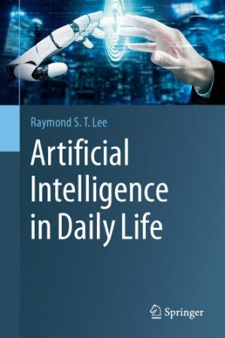
Referensi

Slide 14
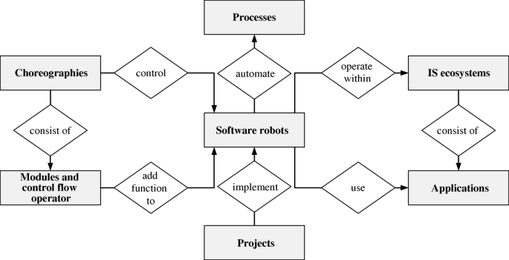
1. Robotic Process Automation (RPA)
Sumber: https://link.springer.com/article/10.1007/s12525-019-00365-8

Slide 15
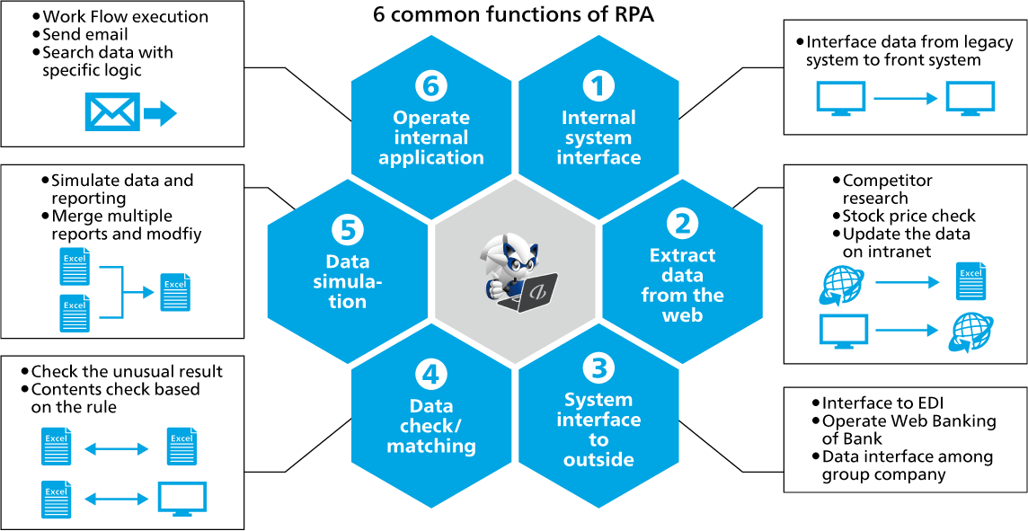
1. Robotic Process Automation (RPA)
Notes:
Sumber: https://www.abeam.com/id/en/service_line/RPA

Slide 16
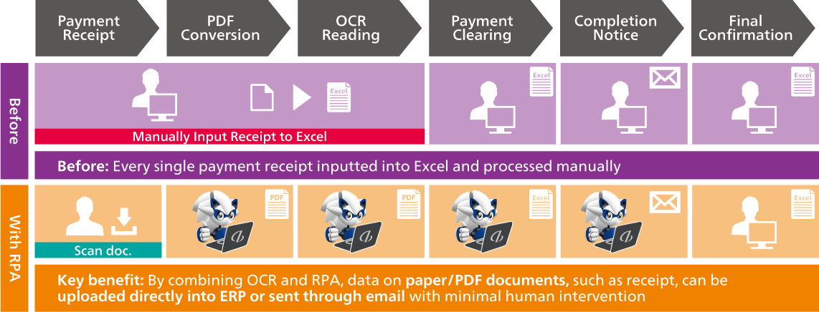
1. Robotic Process Automation (RPA)
Notes:
Sumber: https://www.abeam.com/id/en/service_line/RPA

Slide 17
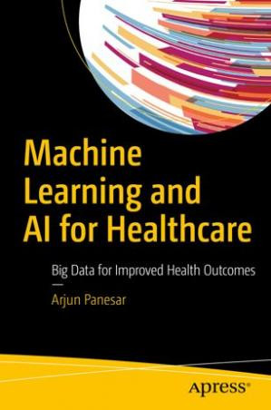
2. AI in Healthcare

Slide 18
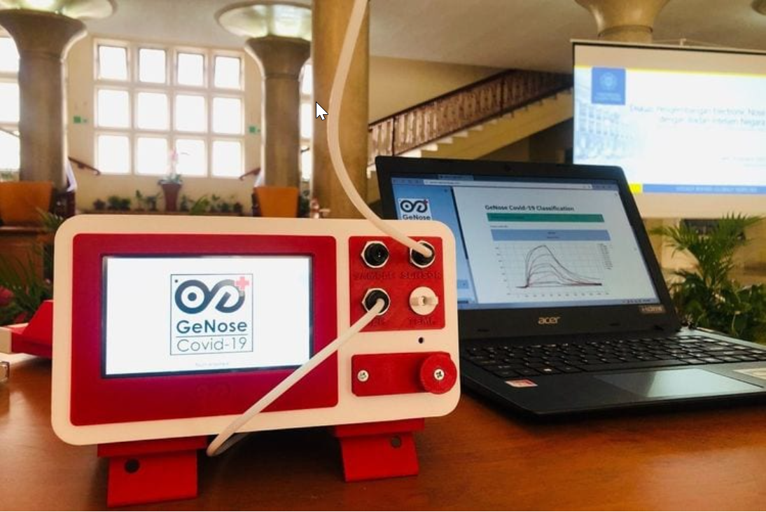
2. AI in Healthcare: Special Covid-19!
GeNose mengidentifikasi virus corona dengan cara mendeteksi Volatile Organic Compound (VOC).
tidak mendeteksi virusnya secara langsung. Yang mereka deteksi adalah metabolit gas ketika seseorang terinfeksi virus
Komposisi gas dalam napas manusia itu juga dapat membedakan satu penyakit dengan penyakit lain. Untuk melacak komposisi ini, tim UGM menggunakan kecerdasan buatan (artificial intelligence/AI) karena harus mengecek ribuan komposisi gas tersebut.
https://www.kompas.com/tren/read/2020/12/26/192900765/cara-kerja-genose-alat-deteksi-covid-19-buatan-ugm-yang-dapat-izin-edar

Slide 19
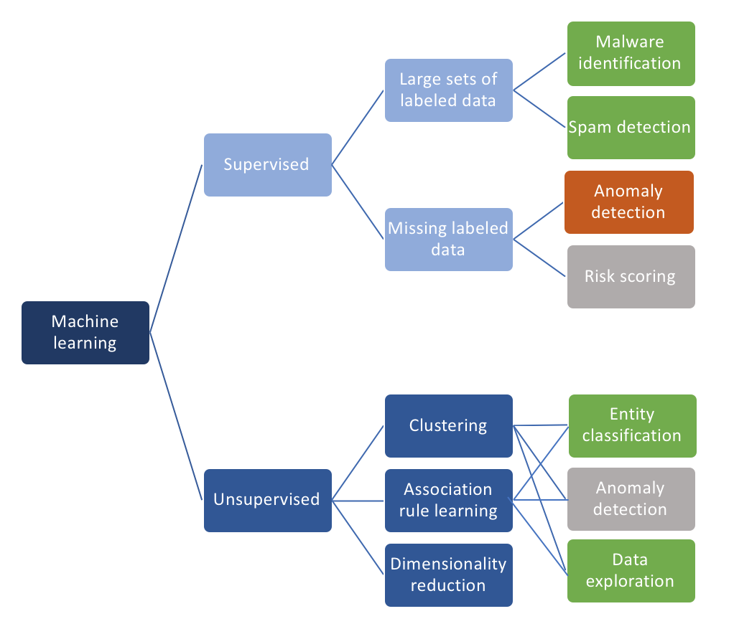
3. AI for Cybersecurity & Data Breaches
https://towardsdatascience.com/ai-and-machine-learning-in-cyber-security-d6fbee480af0

Slide 20
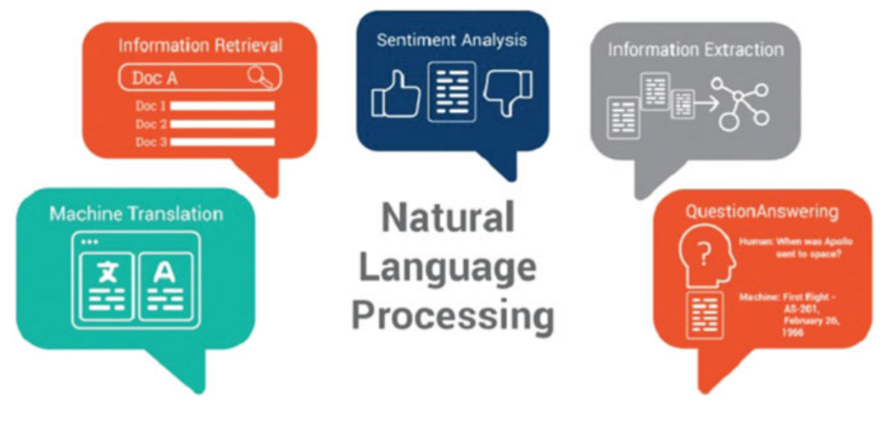
4. Natural Language Processing (NLP)

Slide 21
5. Reinforcement Learning

Slide 22
6. The Joining of the Internet of Things with AI (AIoT)

Slide 23
7. Facial Recognition- A Breakthrough in 2021

Slide 24
8. Enhanced Focus on Quantum AI

Slide 25
9. AI-Powered Business Processing, Forecasting, and Analysis

Slide 26
10. Edge Computing

